Slide 1
Evolution-based Fine-tuning of CNNs for Prostate Cancer Detection
Sara Khosravi
October 2021

Slide 2

Overview
Cited 2 times
Published in 2019
To appear in (NeurIPS 2019)
Currently arxiv

Slide 3
Methods
3

Slide 4
Preprocesses
DW-MRI images from 414 prostate cancer patients (5,706 2D slices) were used as the dataset.
6 DWI sequences were included for each slice
Images were preprocessed and prostate regions were cropped using manual contours of the prostate. Each prostate region was resized to 64 × 64 pixels.
The dataset was divided into training (217 patients, 2,955 slices), validation (102 patients, 1,417 slices), and test sets (95 patients, 1,334 slices).
Label for each slice was generated based on the targeted biopsy results where a clinically significant prostate cancer (Gleason score>6) was considered a positive label (binary classification task).

Slide 5
Method
During the training process, while loss is being minimized, AUC is monitored and the best performing model is selected based on the highest AUC. The challenge here is that a model optimized for minimum loss may not necessarily produce the best possible AUC.
Solution: fine-tuning with genetic algorithm to achieve a higher AUC

Slide 6
Methods
The initial population of our GA includes 512 instances of the classifier (3 FC layers of the CNN). One instance is extracted from the trained CNN model while the remaining 511 instances are randomly initialized. Classifiers (instances) are ranked based on their AUC performance for the training set. Top half of the instances are transferred to the next generation. They are then crossed over and mutated to produce two remaining quarters of the generation. Mutation occurs with probability of 1%. As long as the maximum AUCs on the validation and training sets are improved, this process continues.

Slide 7
Methods
Weights of CNN layers were initialized by Xavier method.
All biases and weights of FCs were randomly initialized from a uniform distribution over [0, 1].
The model was trained based on Cross Entropy loss function and optimized by Stochastic Gradient Descent (SGD).

Slide 8
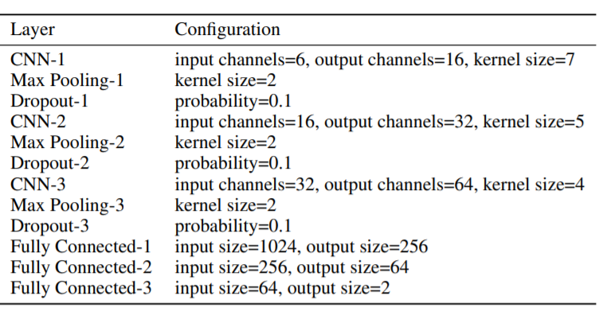
Methods
Fig1. CNN Architecture

Slide 9
Methods
The initial population of our GA includes 512 instances of the classifier (3 FC layers of the CNN). One instance is extracted from the trained CNN model while the remaining 511 instances are randomly initialized. Classifiers (instances) are ranked based on their AUC performance for the training set. Top half of the instances are transferred to the next generation. They are then crossed over and mutated to produce two remaining quarters of the generation.

Slide 10
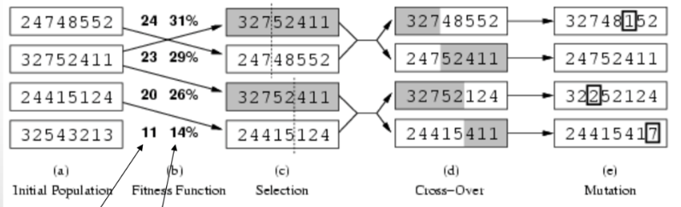
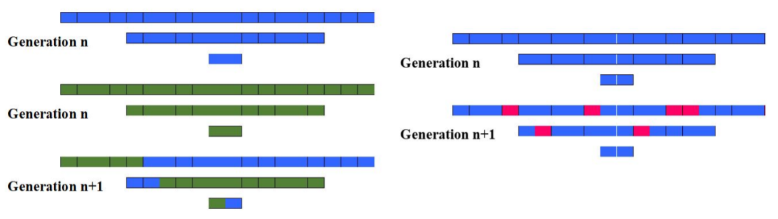
Methods
Fig2. GA algorithm

Slide 11
Evaluation

Slide 12
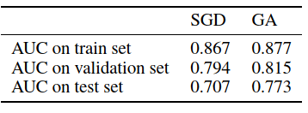
Results
Metric: AUC
Reached best results in epoch 10 although had 50 epochs
Learning rate: 0.001
Fig3. Results

Slide 13
Challenges
High computational cost of GAs
Huge memory
Solution: applying a GA to only FC layers
apply crossover and mutation operations at layer level, instead of individual nodes
(do not optimize each individual weight and bias of the classifier)
optimize parents and offsprings are in the form of an entire layer.

Slide 14
Thanks For Your Attention
Any Questions?
Contact: srkhsrv21@gmail.com

